Slide 1
Classification of Cancer Cells Using Machine Learning Model (SVM)
Arunima Varma
September 22, 2020

Slide 2
Breast Cancer
Breast cancer is the most common cancer amongst women in the world. It accounts for 25% of all cancer cases, and affected over 2.1 Million people in 2015 alone
Early diagnosis significantly increases the chances of survival. The key challenges upon detection is how to classify tumours into malignant or benign.
A tumour is considered malignant if the cells can grow into surrounding tissues or spread to distant areas of the body.
A benign tumour does not invade nearby tissue nor spread to other parts of the body the way cancerous tumours can.

Slide 3
Machine Learning for Cancer Diagnosis
Machine Learning is a sub-field of Artificial Intelligence that gives systems the ability to learn themselves without being explicitly programmed to do so. Machine Learning can be used in solving many real-world problems. ML techniques can dramatically improve the level of diagnosis in breast cancer. Research shows that experienced physicians can detect cancer by 79% accuracy, while a 91% accuracy can be achieved using ML techniques.

Slide 4
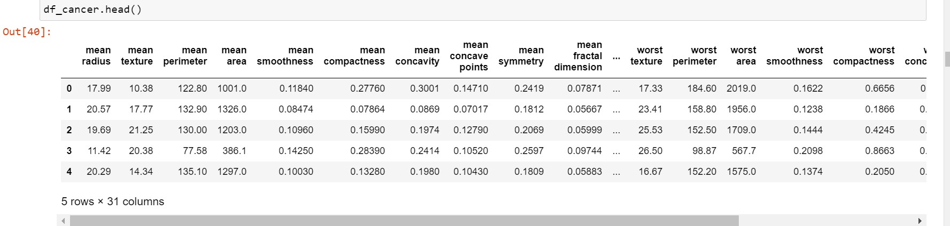
Data Acquisition and Cleaning
Scikit-learn comes with a few small standard datasets that do not require downloading any file from any external website. The dataset that I will be using for our machine learning problem is the Breast cancer Wisconsin (diagnostic) dataset. The dataset includes several data about the breast cancer tumours along with the classification labels, viz., malignant or benign.

Slide 5
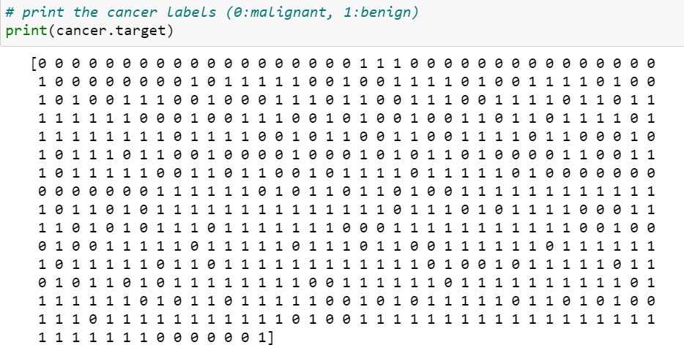
Feature Selection
We see that each dataset of a tumour is labelled as either ‘malignant’ or ‘benign’. From here, each label is linked to binary values of 0 and 1, where 0 represents malignant tumours and 1 represents benign tumours.

Slide 6
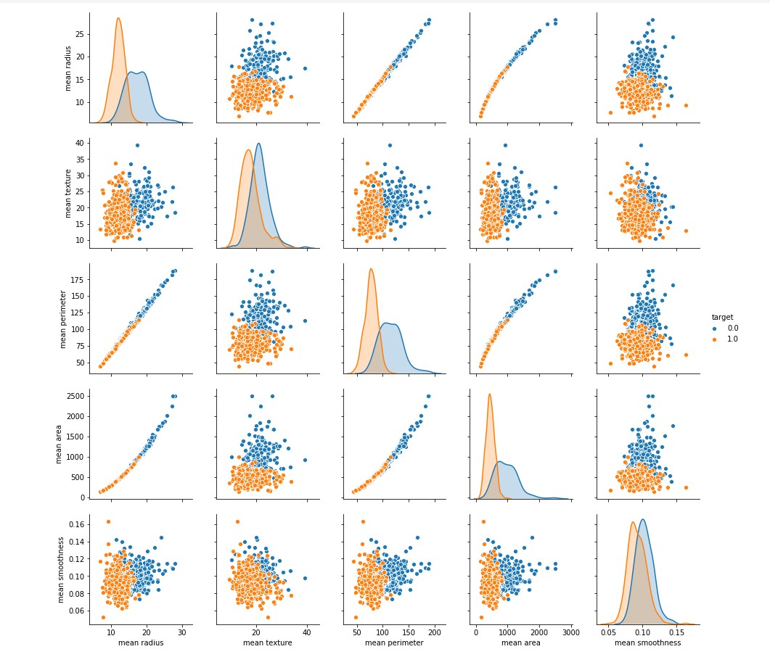
Visualize the relationship between features

Slide 7
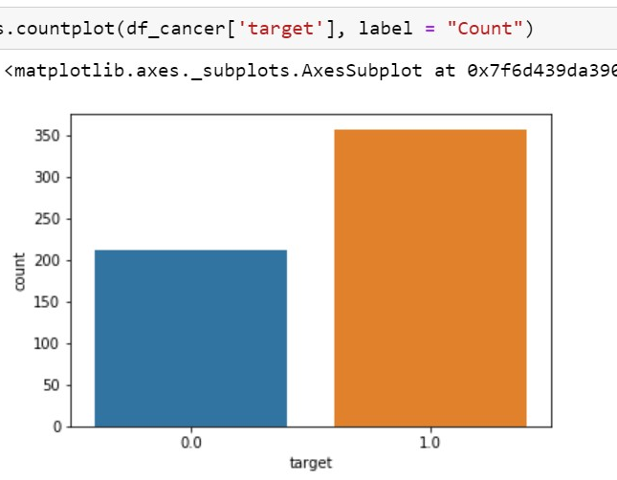
How many Benign and Malignant do we have in our dataset?
This can be visualized as follows:
Note:
1.0 (Orange) = Benign (No Cancer)
0.0 (Blue) = Malignant (Cancer)

Slide 8
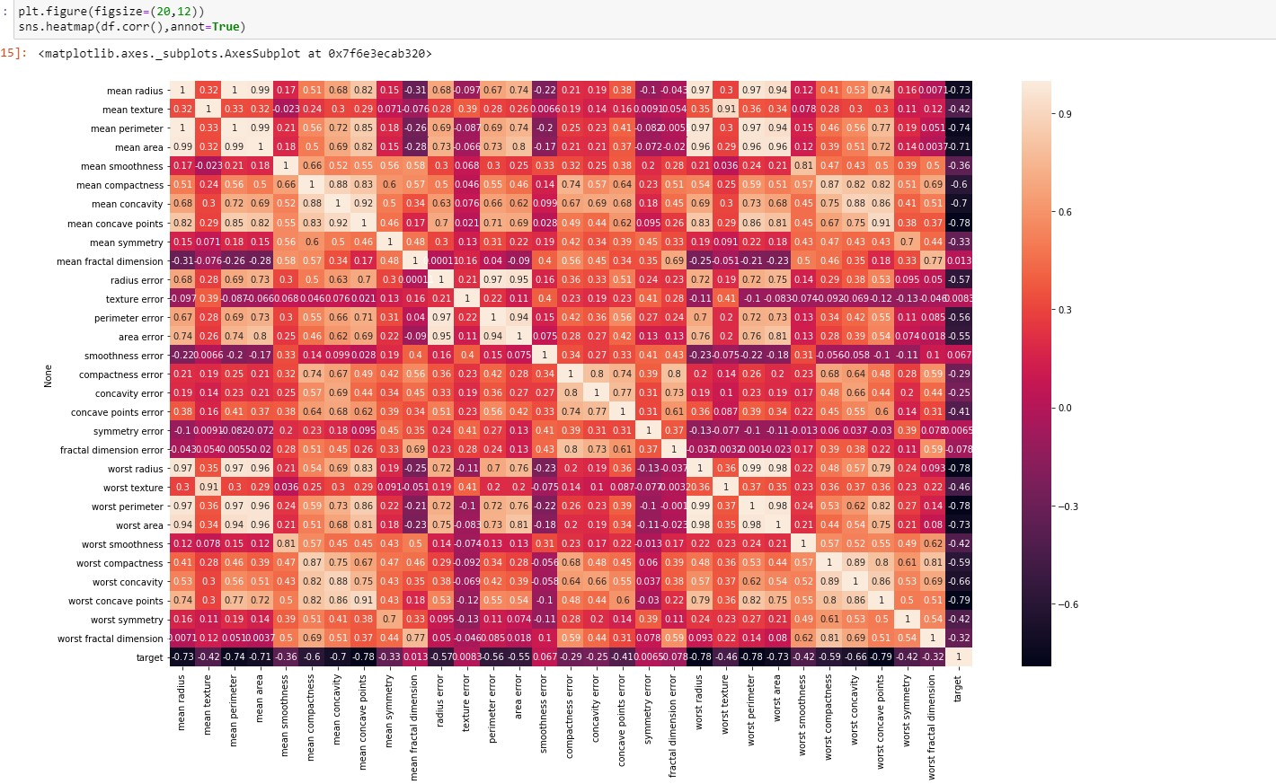
Let's check the correlation between our features

Slide 9
Introduction to Classification Modeling: Support Vector Machine (SVM)
SVM offers very high accuracy compared to other classifiers such as logistic regression, and decision trees. It is known for its kernel trick to handle nonlinear input spaces. It is used in a variety of applications such as face detection, intrusion detection, classification of emails, news articles and web pages, classification of genes, and handwriting recognition.
SVM is an exciting algorithm and the concepts are relatively simple. The classifier separates data points using a hyperplane with the largest amount of margin. That's why an SVM classifier is also known as a discriminative classifier. SVM finds an optimal hyperplane which helps in classifying new data points.

Slide 10
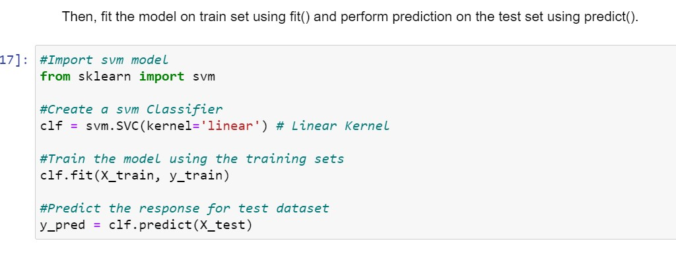
Generating Model
To build support vector machine model:
First, import the SVM module and create support vector classifier object by
passing argument kernel as the linear kernel in SVC() function.
Then, fit the model on train set using fit() and perform prediction on the test set using predict().

Slide 11
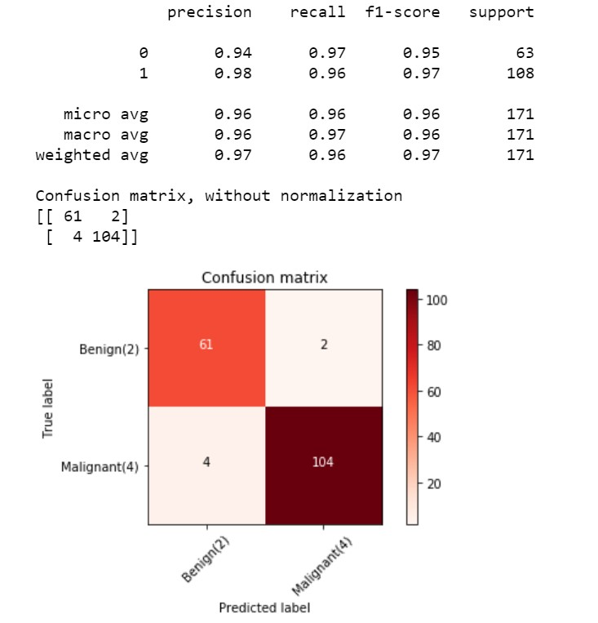
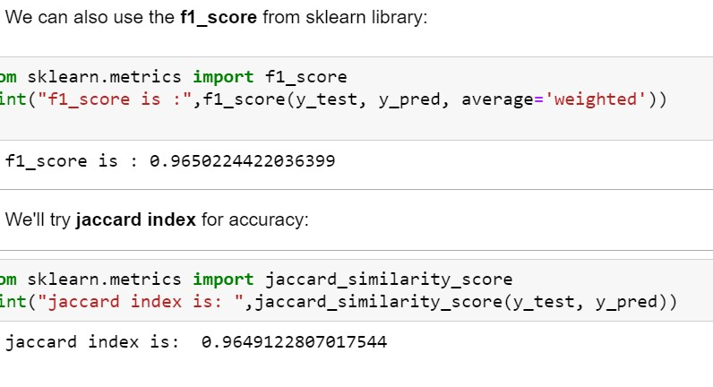
Evaluating the Model
Confusion Matrix:
F1_Score and Jaccard Index:

Slide 12
The advantages and Disadvantages of SVM
Advantages:
Disadvantages:
Effective in high dimensional spaces.
Uses a subset of training points in the decision function (called support vectors), so it is also memory efficient.
Versatile: different Kernel functions can be specified for the decision function.
If the number of features is much greater than the number of samples, avoid over-fitting in choosing Kernel functions and regularization term is crucial.
SVMs do not directly provide probability estimates.

Slide 13
Conclusion
This project took us through the journey of explaining what “modelling” means in Data Science, An introduction to Support Vector Machine (SVM), advantages and disadvantages of SVM, Training an SVM model to make accurate breast cancer classifications, Evaluating the performance of an SVM model, and testing model accuracy using Confusion Matrix.

